Slide 1

Innovation Hub | Florida State University
Presentation by Ken Baldauf
Innovation Hub Director
Notes:
I first started talking with Provost. McCrory about Innovation Centers three years ago, as a possible next step for our Program in Interdisciplinary Computing. She responded to the idea enthusiastically and encouraged me to explore what an Innovation Center would look like at FSU.
I’d like to share with you a very small bit of what I’ve learned, and bring you up to speed on the FSU’s Innovation Hub and how it relates to you.

Slide 2
GOT INNOVATION?
Elon Musk: Tesla, SpaceX, SolarCity, Boring Company, PayPal – worth $15 billion
Notes:
THE POSTER CHILD FOR 21st CENTURY BUSINESS: ELON MUSK
Audacious
Fearless
Risk-taker
ELON IS NOT ALONE
THE HUNGER FOR INNOVATION IS IMPACTING EVERY BUSINESS AND ORGAINZATION IN EVERY INDUSTRY.
WE MUST PREPARE OUR STUDENTS.

Slide 3
Corporate Innovation Centers
A winning strategy for many Fortune 500 companies
Notes:
THE HUNGER FOR INNOVATION IS IMPACTING EVERY BUSINESS AND ORGAINZATION.

Slide 4
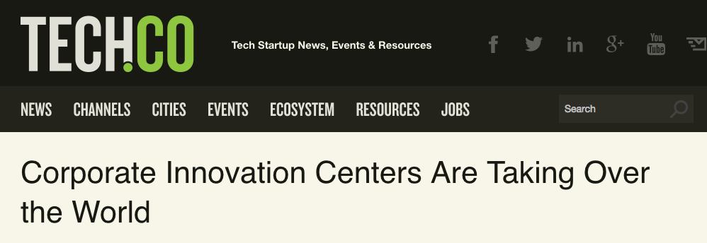
“We live in an era of digital Darwinism, a time when technology and society continually evolve. The reality is that innovation is now a constant, and the net result sets the stage for disruption.”
Corporate Innovation Centers Are Taking Over the World, Brian Solis, Principal Analyst at Altimeter

Slide 5

Dig deeper: www.lowesinnovationlabs.com
Notes:
NOT JUST TECH COMPANIES, BUT FORTUNE 500 COMPANIES ACROSS THE BOARD…

Slide 6
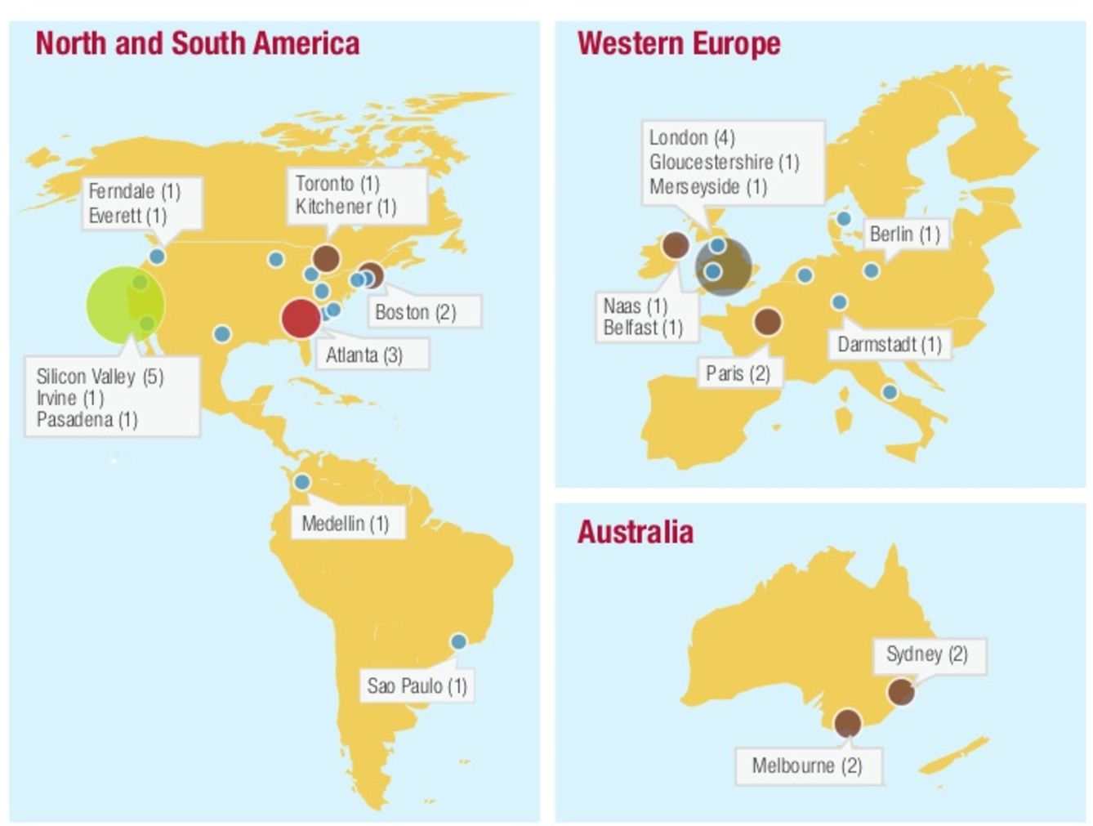
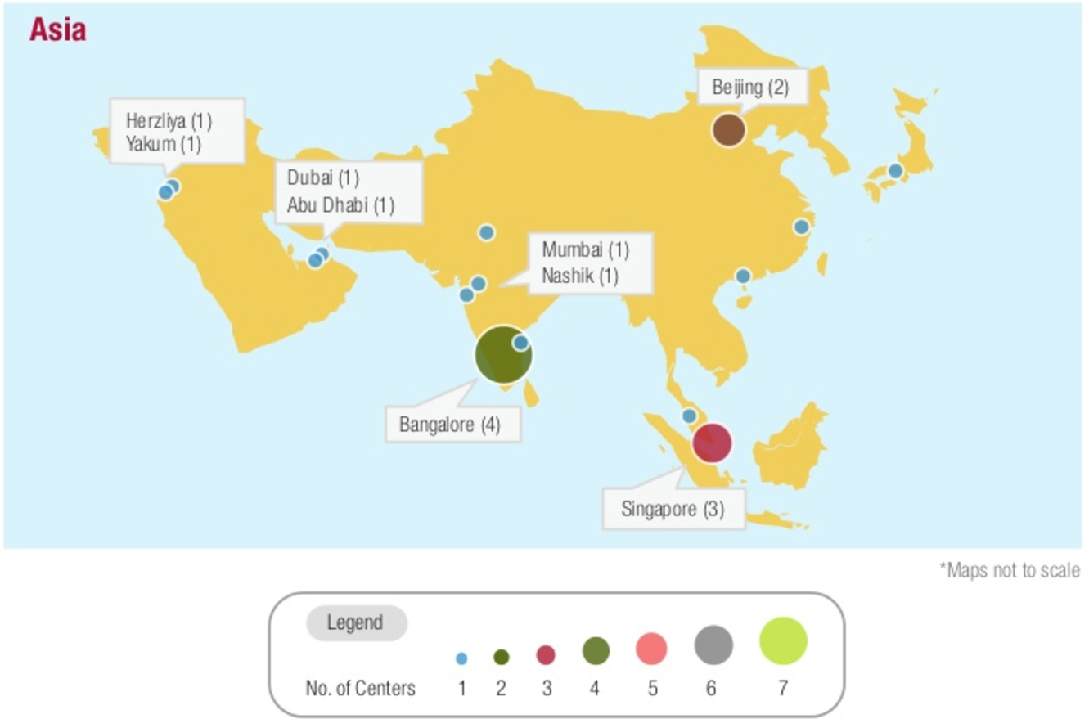
456 Corporate Innovation Centers Worldwide Oct 2016 – up 51 percent from July 2015, here’s where they are building the latest…
The Rise of Innovation Empires Worldwide, Brian Solis, Principal Analyst at Altimeter and Jerome Buvat, CapGemini.
Notes:
…AND AROUND THE WORLD
SILICON VALLEY IS NO LONGER THE ONLY HUB FOR INNOVATION – ATLANTA, BOSTON, TORONTO, LONDON, MELBOURNE, SYDNEY, BANGALORE, BEIJING, SINGAPOR

Slide 7
Dig Deeper: Peek Inside 7 of The Banking World’s Coolest Innovation Labs
Notes:
Innovation Centers are more than trendy places.
They inspire, and support specific innovation frameworks and methods designed to allow new and promising ideas to emerge.
Big open spaces, with inspiring décor, where experts collaborate and brainstorm.
Whiteboards, post-its, freedom and equality
Not about the place, but about the culture

Slide 8
Innovate or Implode
Addressing
Complex
Challenges
Incorporating
New
Technologies
Maintaining
Competitive
Advantage
Meeting
Customer
Demand
Notes:
INNOVATION = SURVIVAL
MANY FORCES ARE DRIVING THIS CHANGE
AND IT’S NOT JUST ABOUT MONEY
Elon Musk innovates to save the planet, send people into space, and eliminate traffic.

Slide 9
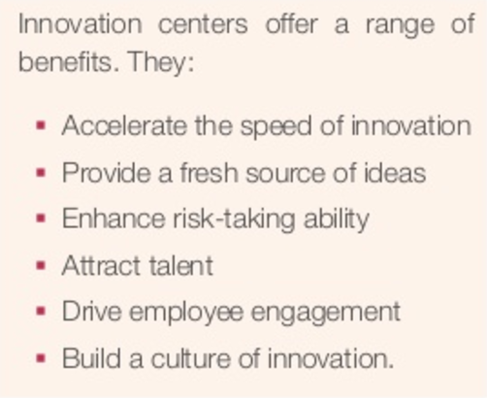
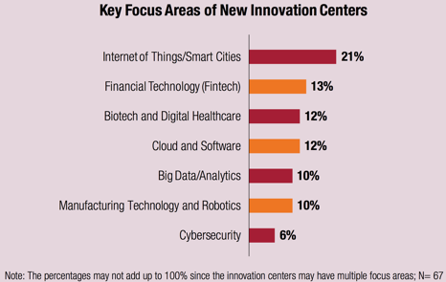
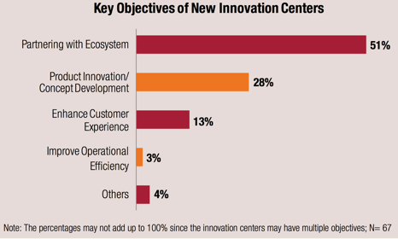
Innovate or Implode
Benefits
Tech Driven
Partnering with Startups
Notes:
SOME FINDING’S FROM SOLIS’S STUDY

Slide 10
University Innovation Centers
Preparing students for the innovation-driven workplace
Notes:
Many approaches

Slide 11

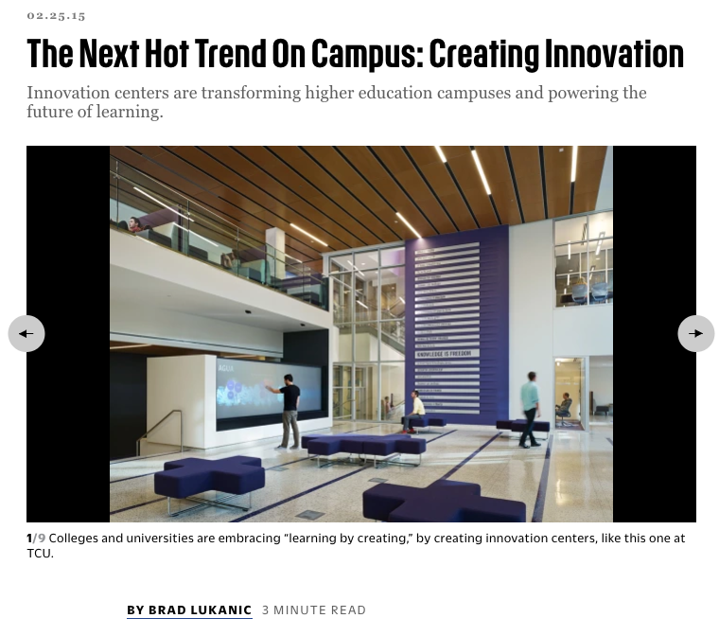
As tomorrow’s global citizens enter higher education with words like “make,” “hack,” and “prototype” embedded in their vocabulary, they are fueling a powerful movement toward “learning by creating.”
Notes:
INNOVATION CENTERS ARE TRANSFORMING HIGHER ED

Slide 12
Innovation Colab @ Duke
Notes:
Learning by Creating: Things
ENGINEERING FOCUS – InVenture spaces

Slide 13
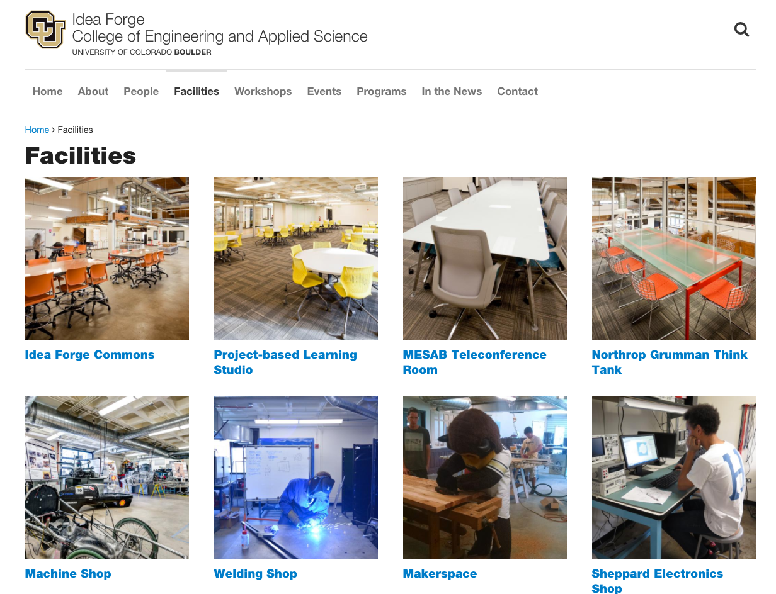
Notes:
ENGINEERING FOCUS – InVenture spaces
UC Boulder

Slide 14
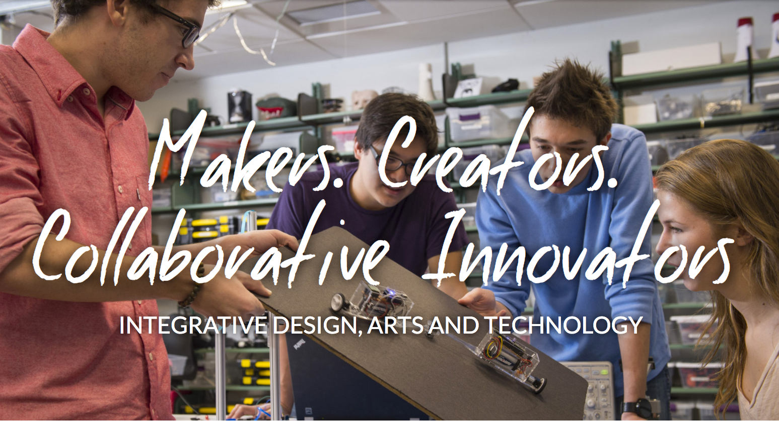
Carnegie Mellon
Notes:
Learn by Creating More Things
Interdisciplinary STEAM Focus
Integrative Design, Arts, and Technology (IDEATE). Carnegie Mellon

Slide 15
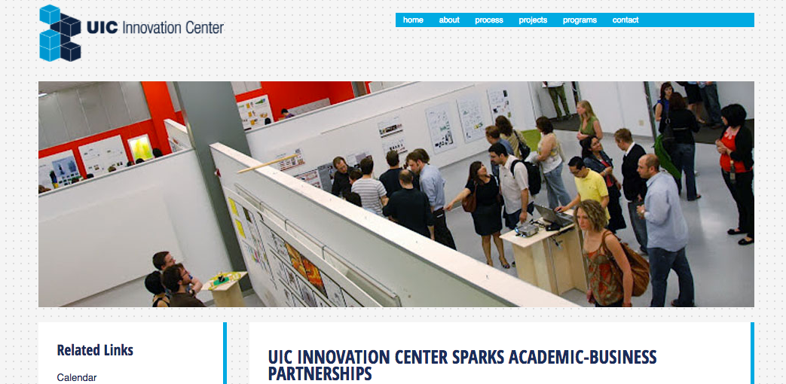
Notes:
“Learn by creating” Solutions
RESEARCH DRIVEN
Designed to spur economic growth
University of Chicago Innovation Center

Slide 16
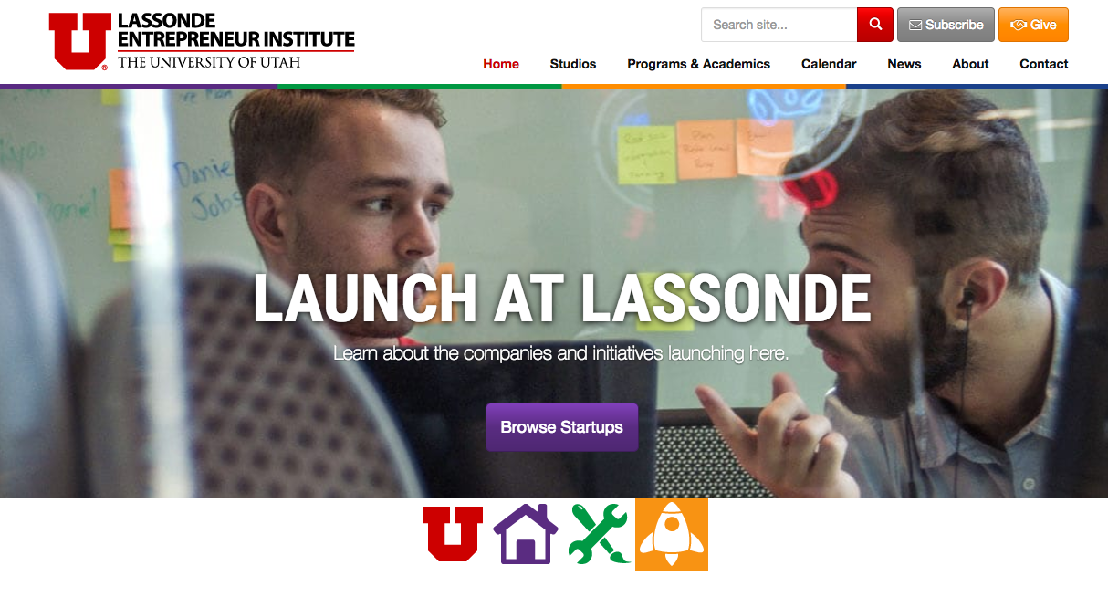
Notes:
Learn by Creating Businesses
Entrepreneurial Focus
University of Utah Lassonde Entrepreneur Institute
Internal and/or External Implementation

Slide 17
Innovation Center @ FSU Planning
The long and winding road
Notes:
Many approaches

Slide 18
Cross-discipline
Tools for
Innovation
Technology
Fablab
Business
Design

Slide 19

FSU
Resources
Jim Moran
School of
Entrepreneurship
H.P.M.I
Office of
Research &
Undergrad Research
Computer Science
L.S.I.
hub
College of
Fine Arts
Arts &
Sciences
Scientific Computing
F.A.R.
Art
Interior Design
FSU Libraries
College of
Education
College of
Engineering
Notes:
Connecting and complimenting sources of Innovation and Entrepreneurship

Slide 20

An Innovation Pipeline
e
r
Jim Moran
School of
Entrepreneurship
Office of
Research &
Undergrad Research
hub
Innovation for the Masses
An Innovation “sandbox” in which ALL students can discover their “Inner Innovator”
Support interdisciplinary and collaborative work
Inspire students with real world challenges
Expose students to new technologies
Instruct students in “Innovation Frameworks”
Undergrad Focus

Slide 21
Design Thinking
Empathize
(Re)Frame
Ideate
Prototype
Test
Diverge
Converge
Diverge
Converge
Human-centered design
Inclusive, Empathetic Collaborative Problem-solving
Dig Deeper:
Dig Deeper:
https://www.interaction-design.org/literature/article/5-stages-in-the-design-thinking-process
http://www.ideou.com/pages/design-thinking
https://dschool.stanford.edu/resources-collections/a-virtual-crash-course-in-design-thinking
https://www.ibm.com/design/thinking/
https://www.interaction-design.org/literature/article/5-stages-in-the-design-thinking-process
http://www.ideou.com/pages/design-thinking
https://dschool.stanford.edu/resources-collections/a-virtual-crash-course-in-design-thinking
https://www.ibm.com/design/thinking/

Slide 22

An Interdisciplinary Hub
Academic Partners
Jim Moran School
Fine Arts
iSchool
CCI
Engineering
Arts & Sciences
Education
Social Sciences
Founding Partners
Provost
Libraries
External Partners

Slide 23


Key Ingredients
Innovation Hub provides:
Access to new technologies
Innovation frameworks: design thinking
Space, staff and support
Partners (internal and external) provide:
Subject-area expertise
Transdisciplinary collaboration
Design challenges
Student driven

Slide 24
www.innovation.fsu.edu
Thank you!
Ken Baldauf
kbaldauf@innovation.fsu.edu
850.645.8649

